Slide 1
REJOINING NATURE!
When I first moved West in 1980,
I wanted to BE ONE OF nature’S FRIENDS, so I immediately became involved in environmental groups’ efforts to keep the West wild and wonderful.
Notes:
Inspired by those “Cows destroy the West” photos, and the stories that accompanied them, I became an activist with the
fClub and Earth First! and worked on issues involving wilderness preservation, endangered species, wild and scenic rivers, and...

Slide 2
And then…
Dan Dagget became a relentless environmental advocate, organizing demonstrations for Earth First! and similar groups…
JULY 1999
and received an “Environmental Hero” award as one of the top 100 grass roots environmental activists in America by the Sierra Club for its John Muir Centennial celebration in 1992 based on his work to limit the open-ended character of predator control programs directed at mountain lions and black bears by Arizona ranchers…
TO ACHIEVE THAT GOAL, I began meeting with ranchers…

Slide 3
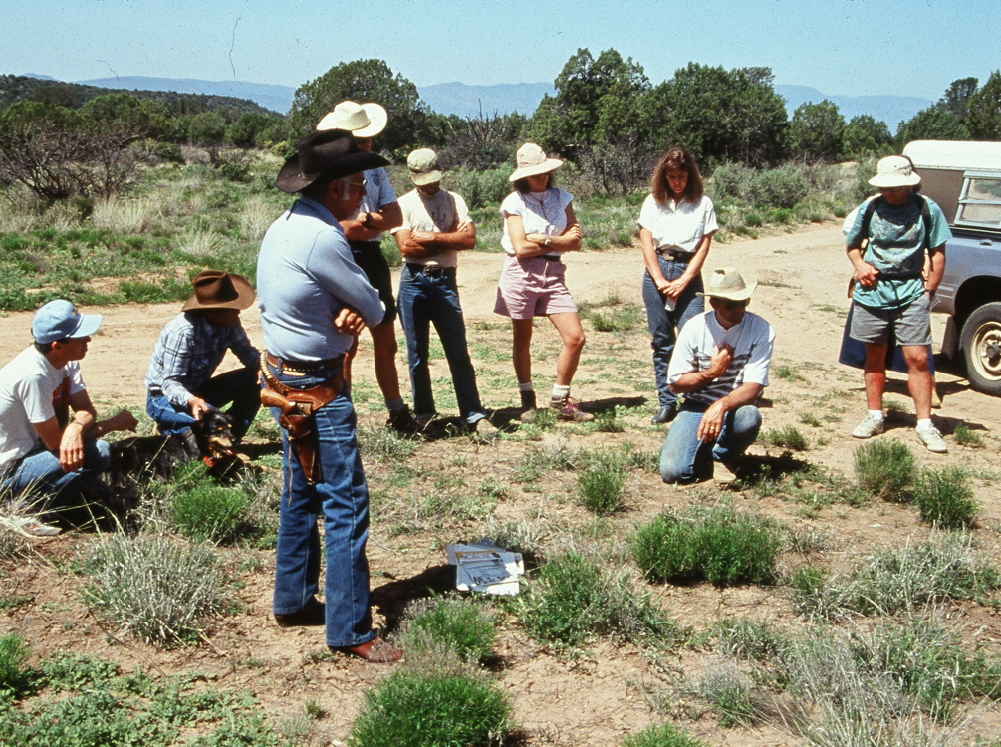
Some of those first meetings were a bit contentious…

Slide 4
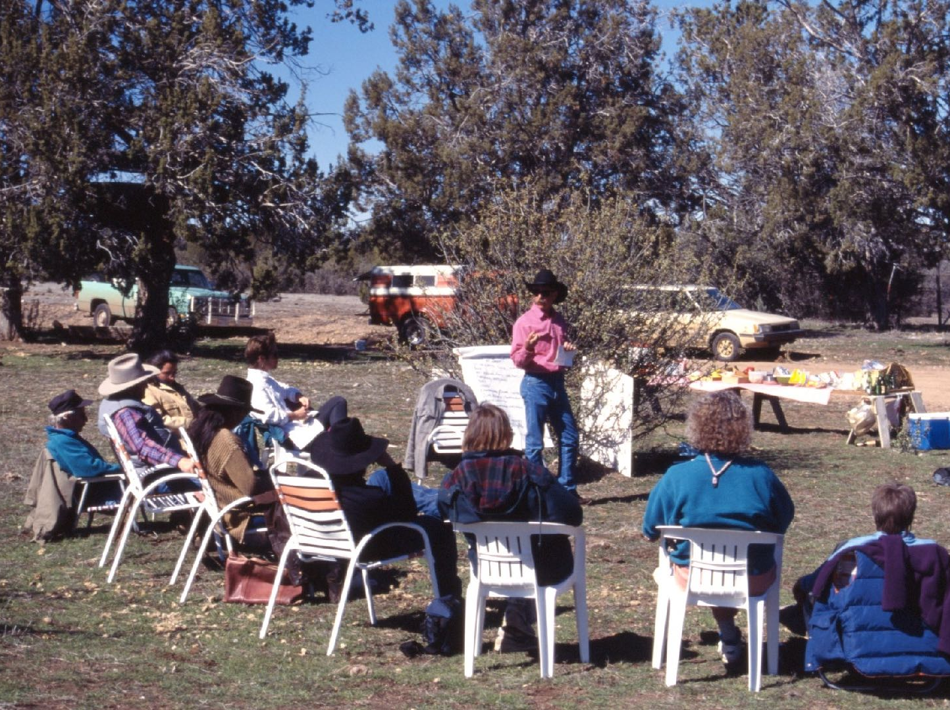
but when we started talking about what we want in the west, we found that, in most cases, ranchers, enviros, recreationists, and even government agencies want the same things.

Slide 5
We want:
*Healthy ecosystems INCLUDING healthy grasslands
*Stable and diverse wildlife populations
*Healthy flowing streams with healthy riparian areas
*Less erosion
*Less desertification
*Fewer wildfires…
**And less climate change

Slide 6
So, we started comparing land that was being grazed in ways intended to achieve the goals we shared
LIKE this ranch in southern Arizona THAT WAS BEING grazed “regeneratively”

Slide 7
With land nearby that had been
protected from grazing to achieve those same goals
Photos same day
Like This “protected” land RIGHT ACROSS THE FENCE from the previous photo

Slide 8
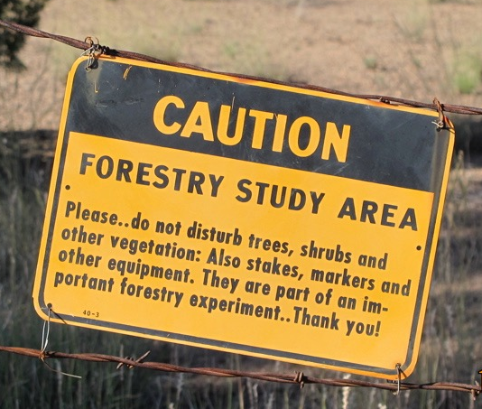
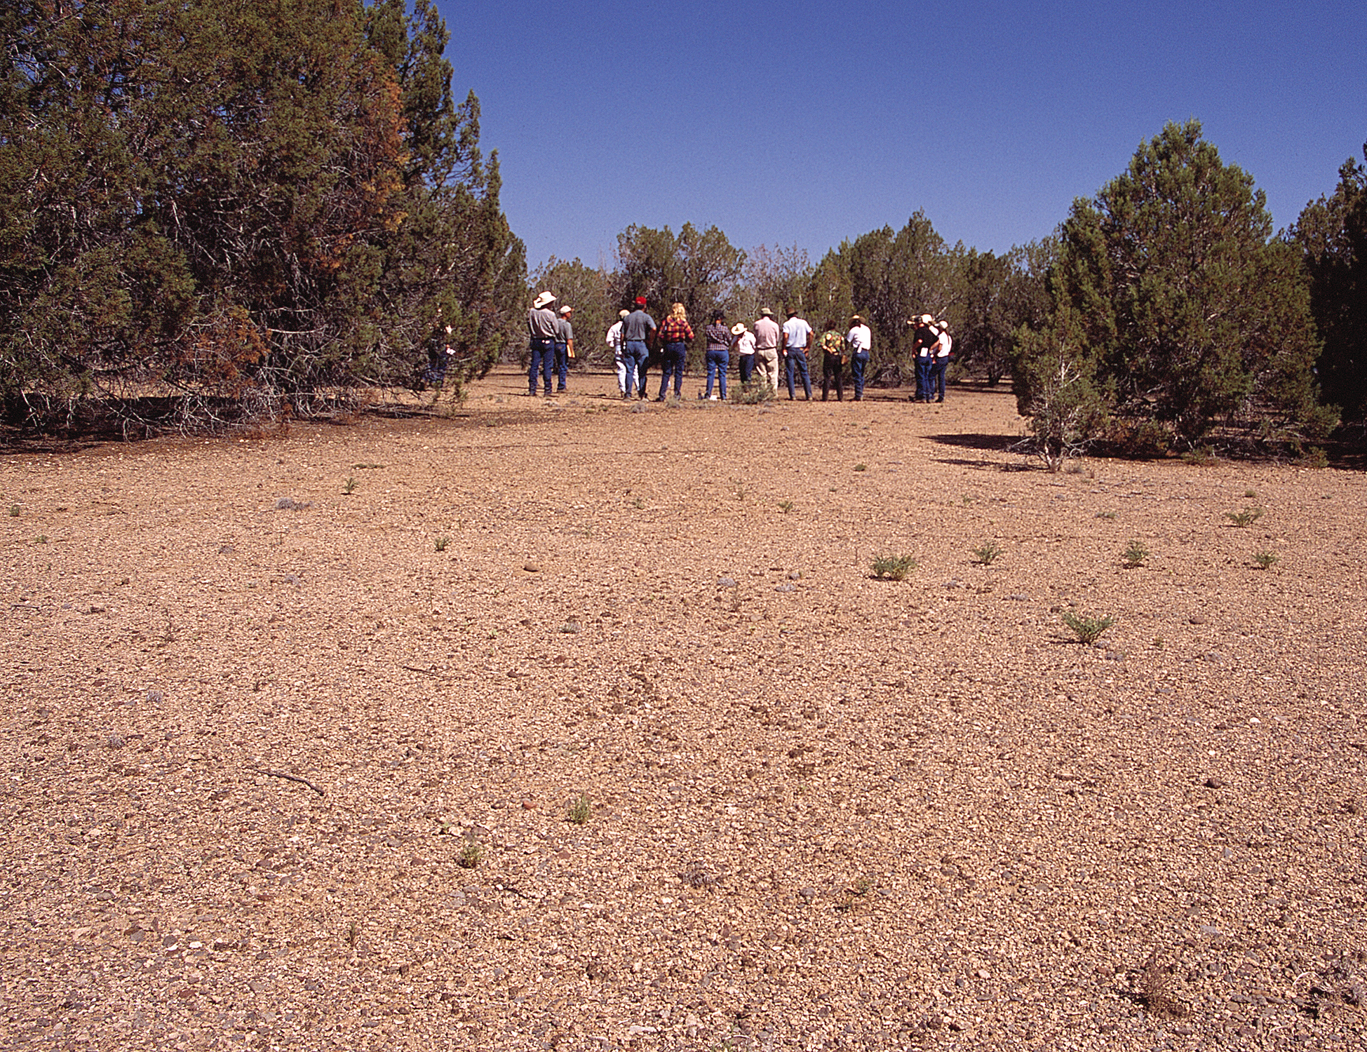
Here’s something else that happens when we remove grazing to achieve eco-goals
Grazing WAS REMOVED FROM THIS forest service STUDY AREA near Prescott, az IN 1946
Photo 2005

Slide 9
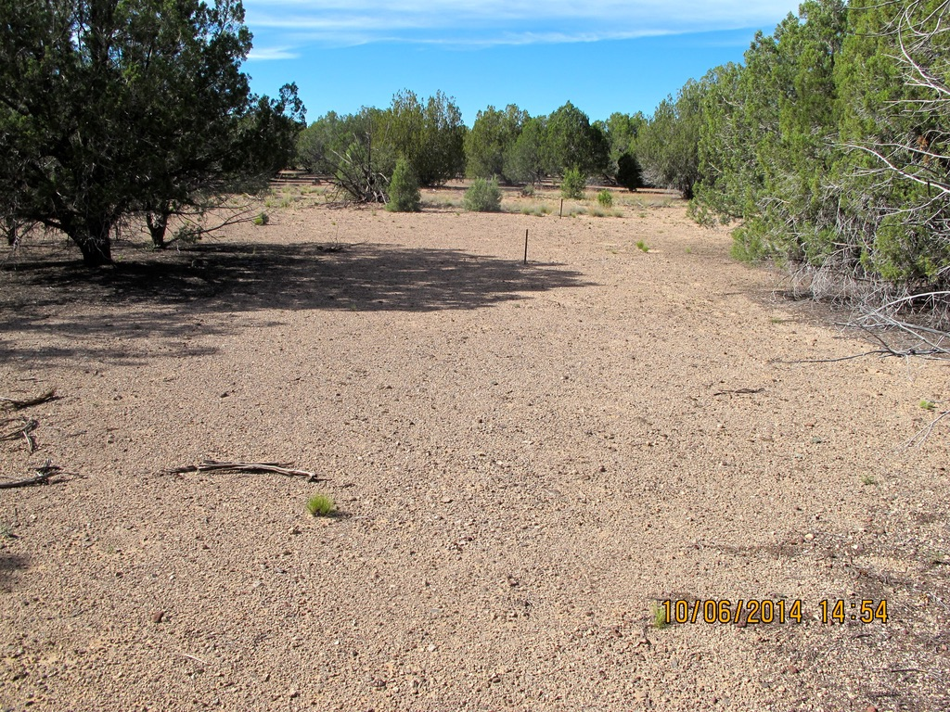
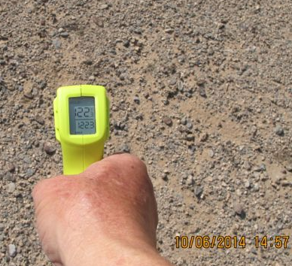
How well did this achieve the shared goals of ranchers, enviros, recreationists, and government agencies?
122°
Healthy ecosystem & healthy grassland?
Stable and diverse wildlife populations?
Less desertification?
Return to nature?
CLIMATE CHANGE?
Same place 2014
Protected for 68 years

Slide 10
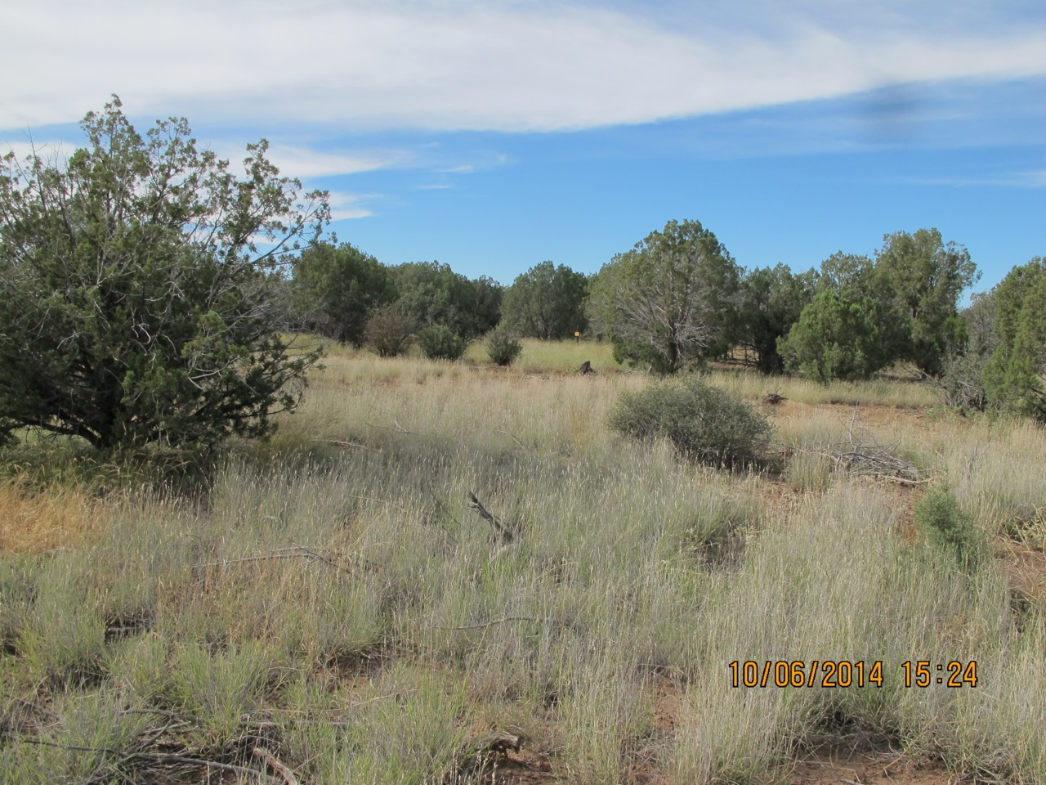

Here’s the land just outside the study area – ranched in a regenerative way
Climate Change?Global Warming?
Shared goals achieved!
Healthy ecosystem & healthy grassland!
Stable and diverse wildlife populations!
Less desertification!
Return to natural function!
Photos taken same day

Slide 11
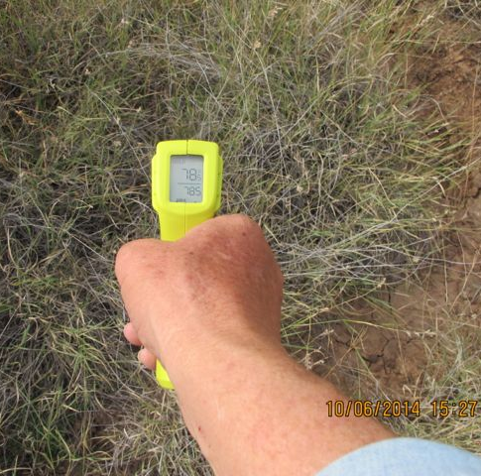
Here’s the land just outside the study area – ranched in a regenerative way
122°
Climate Change?Global Warming?
78°
Inside the study area
Photos taken within a few minutes

Slide 12
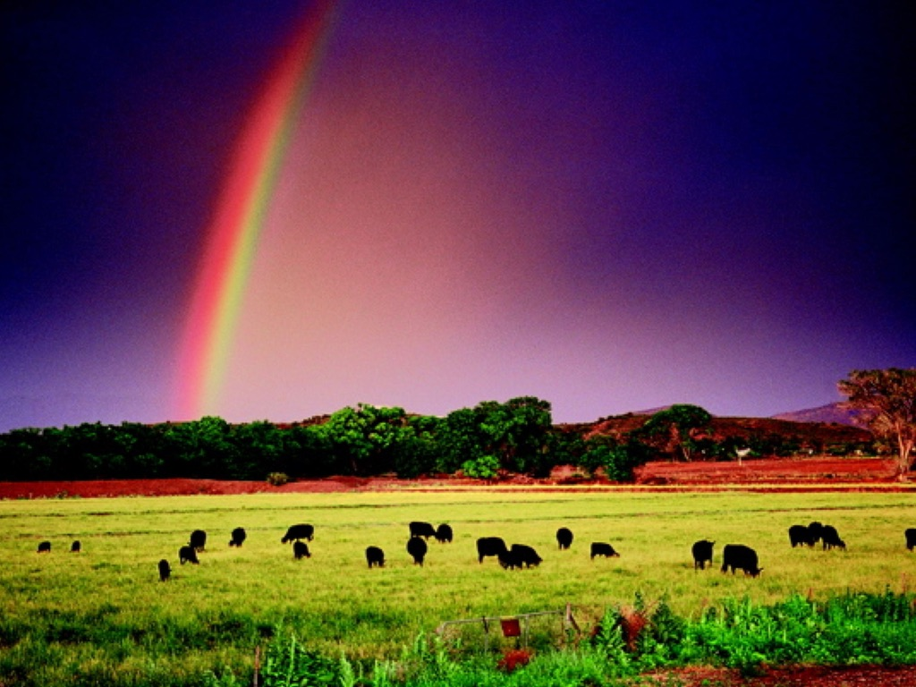
VEGETATIVE COVER, LIKE TREES AND OTHER PLANTS (INCLUDING GRASSES) NOT ONLY COOLS THE LAND, IT FACILITATES RAINFALL BY INCREASING ATMOSPHERIC MOISTURE THROUGH THE PROCESS OF TRANSPIRATION —
PLANTS RELEASE WATER INTO THE ATMOSPHERE THROUGH THEIR LEAVES, WHICH CONTRIBUTES TO CLOUD FORMATION AND IS A KEY COMPONENT OF THE WATER CYCLE

Slide 13
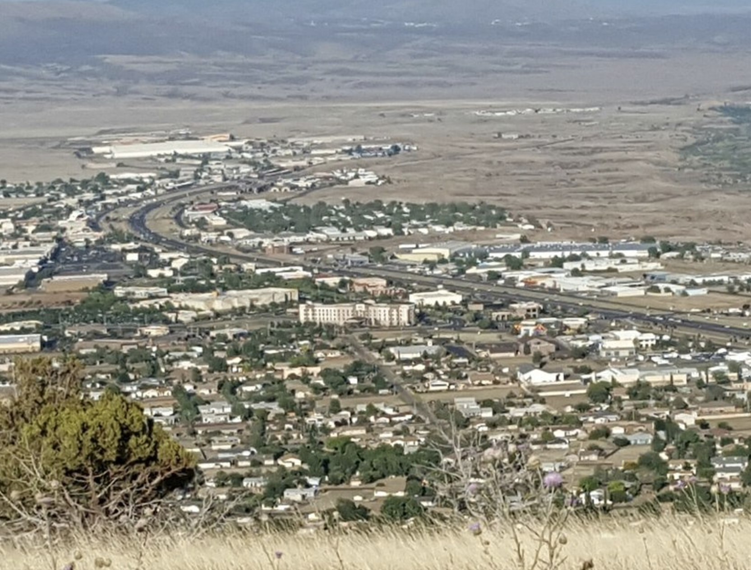
HERE’S what happens on a lot of land where ranching has been removed.

Slide 14
At this point I began to realize that regenerative ranching is really a way to work in partnership with nature!
In other words,
It’s a way to rejoin nature

Slide 15
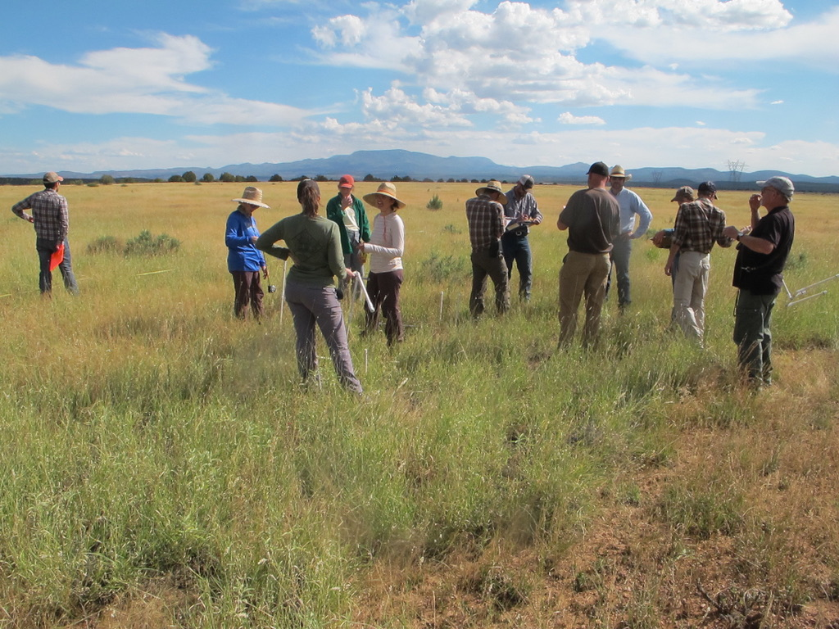
Why REJOINING NATURE is so valuable to so many of us…
From sciencealert.com
when people feel they are enmeshed with nature, they are not only greener in their behavior but they tend to be happier . So I (sciencealert.com) absolutely want my kids to grow up feeling they are part of nature

Slide 16
WHAT’S standing in our way?
the standard definition of Nature: “all the animals, plants, rocks, etc. in the world and all the features, forces, and processes that happen or exist independently of people,”

Slide 17
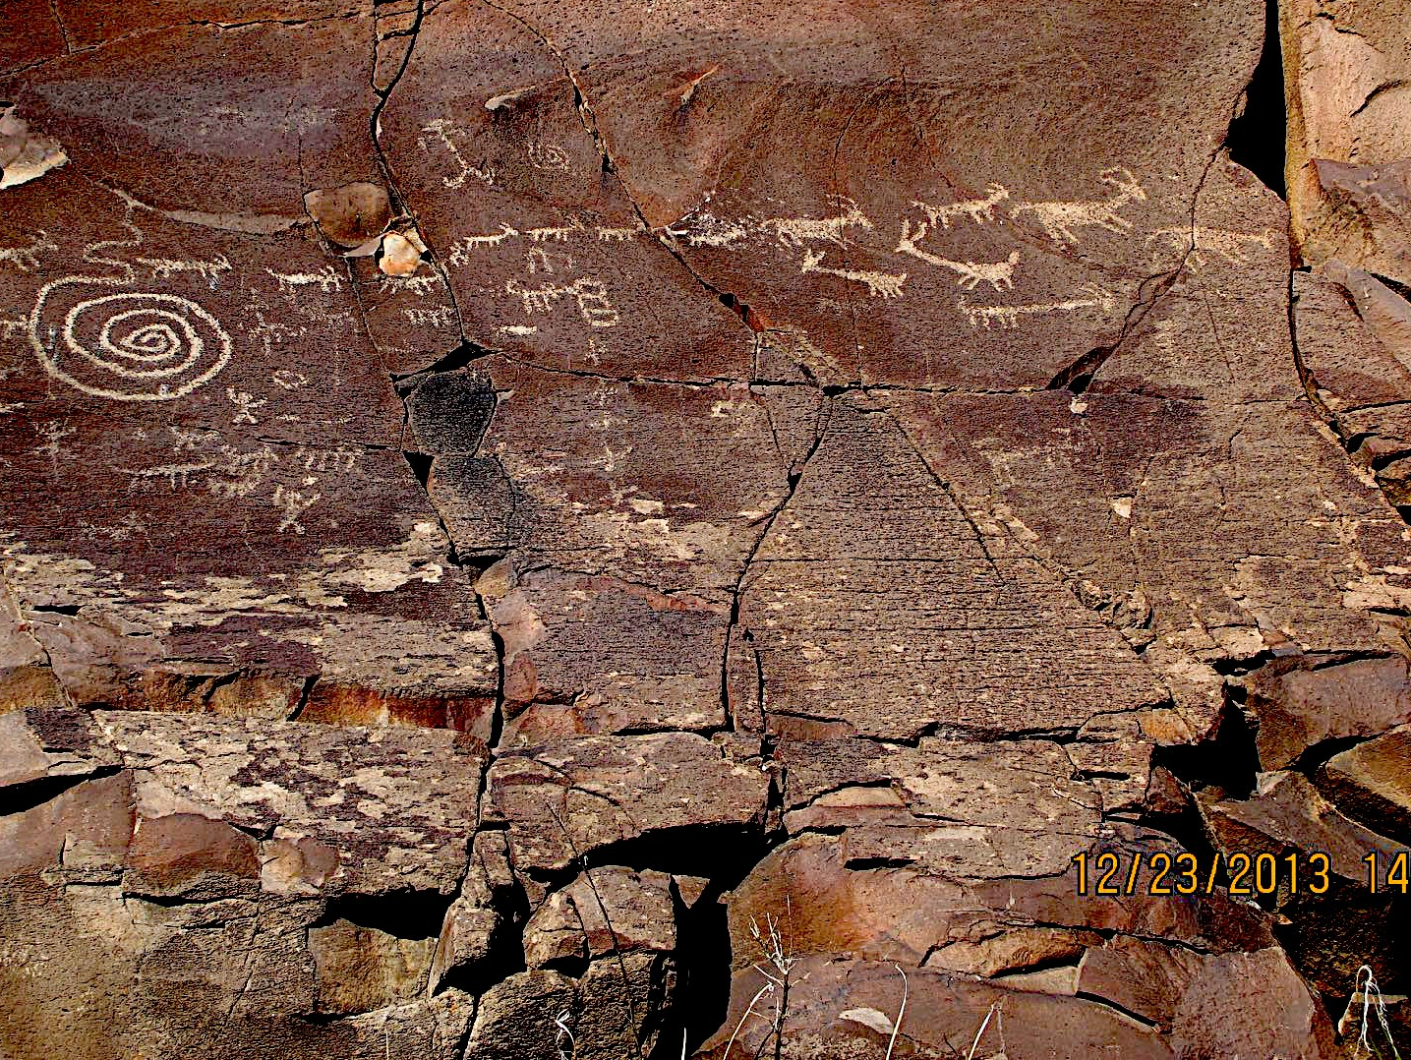


This native American rock art affirms that early inhabitants of the Americas (indigeous americans) worked in partnership with nature by herding bison, elk, and other hoofed grazing animals.
Doing so, they Sustained the great plains and more.

Slide 18
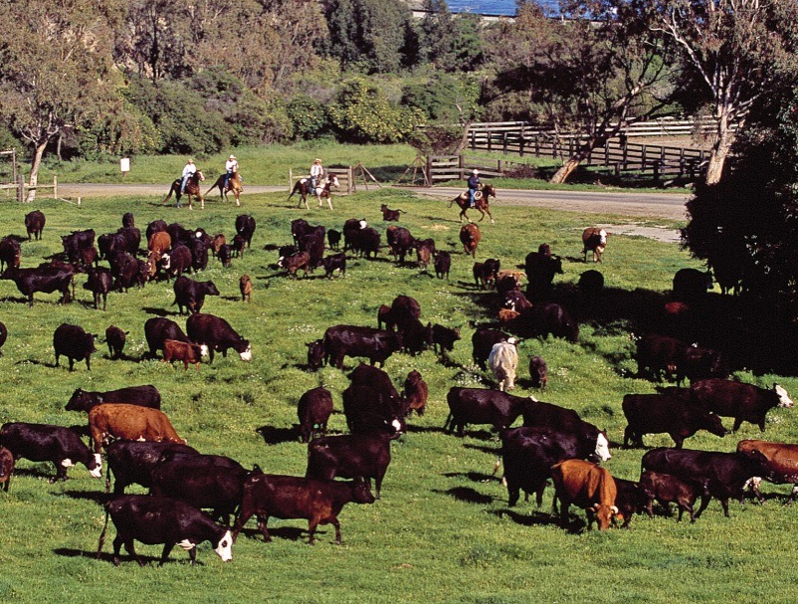
That same mutualism is in action today
Sustaining ecosystems via MUTUALLY BENEFICIAL relationships, HUMANS ARE AS MUCH A PART OF NATURE As other animals AND plants

Slide 19
This is not to say THAT Nature’s message is, “Grazing is good for the environment — period” I have seen enough unimpressively grazed land to mAKE that CLEAR.

Slide 20
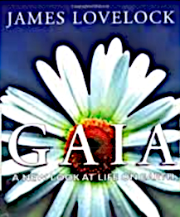
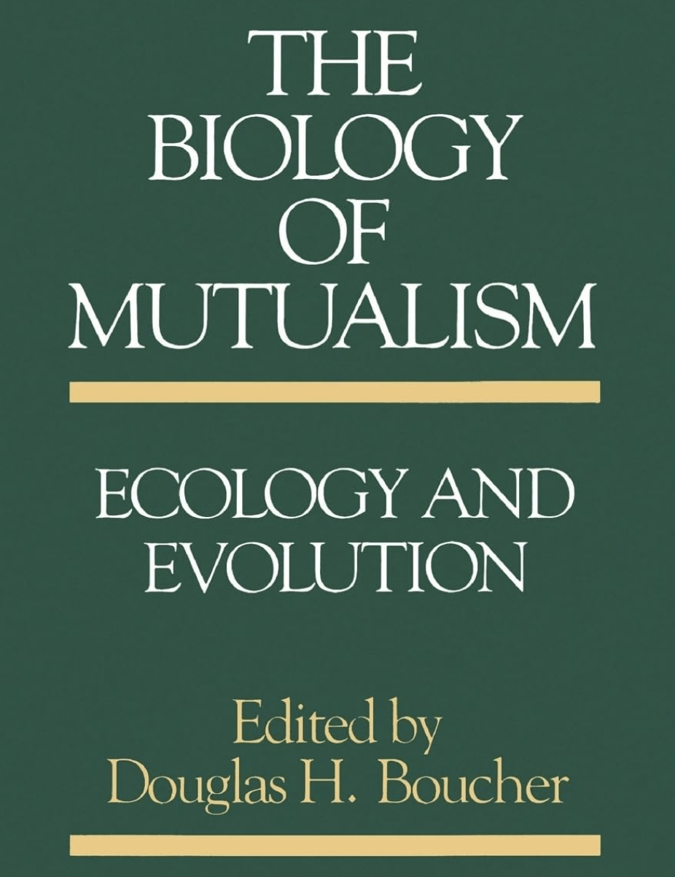

However, A number of scientists have cited the value of evolved mutualistic relationships by which species interact in ways that each provides a benefit to the other…
A NEW LOOK AT LIFE ON EARTH
Symbiotic Earth!
How Lynn Margulis Rocked the Boat and Started a Scientific Revolution…

Slide 21
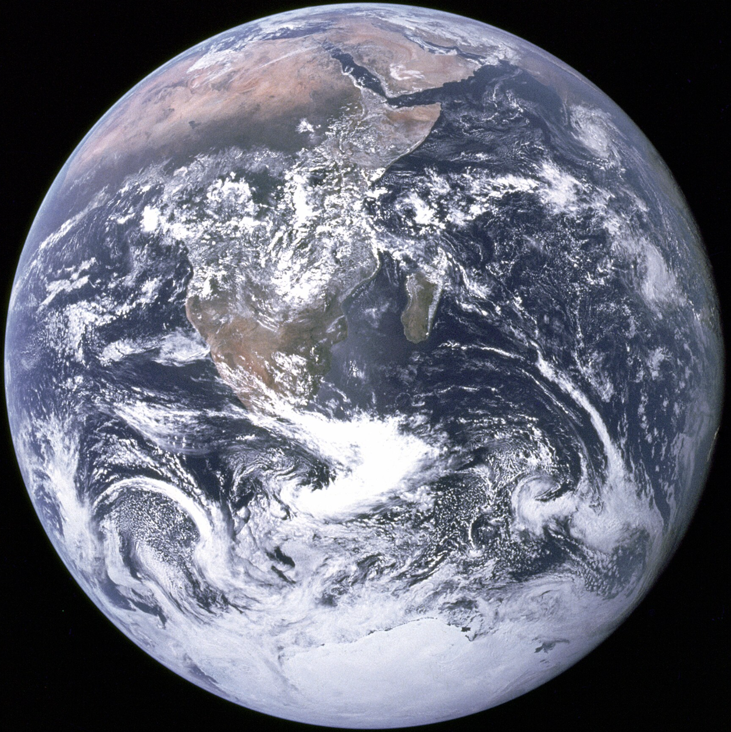

James Lovelock, originator of the Gaia Hypothesis described Nature as “a kind of living organism” with various living components (plants or animals) that function like organs performing life functions.
According to Lovelock plants and animals interact via mutualistic relationships that sustain life-supporting conditions such as:
* Keeping the earthly temperature and the composition of the earthly atmosphere correct for sustaining life.
* interact via relationships that keep the fluid that supports life (water) circulating in a life-sustaining manner and more.

Slide 22
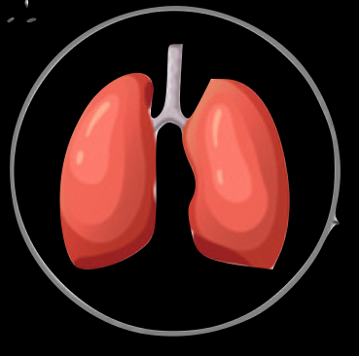
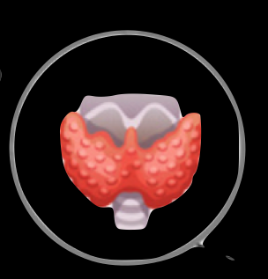
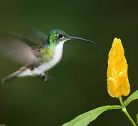
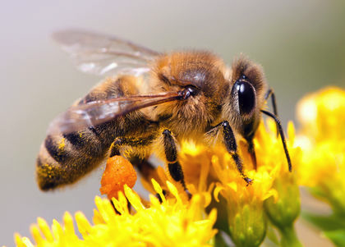

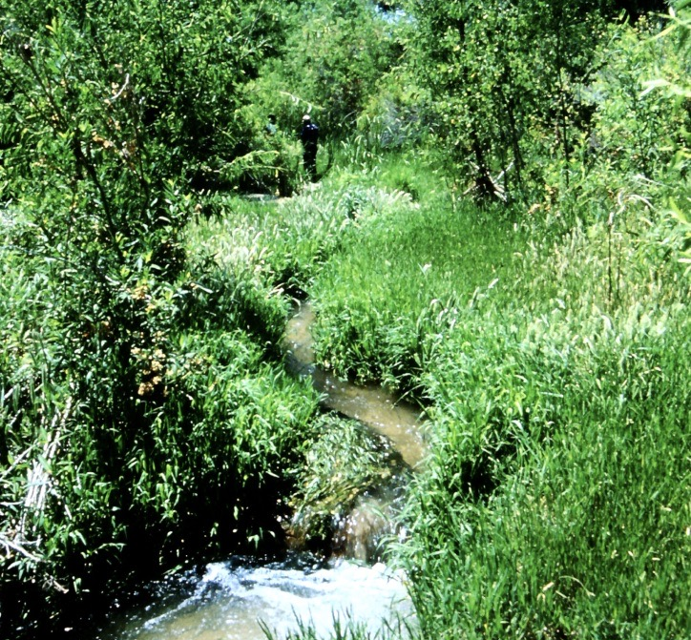

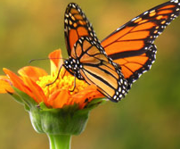
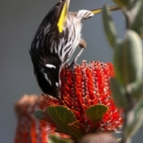

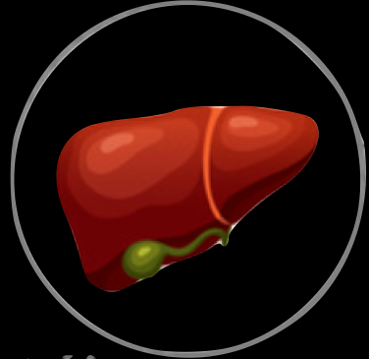
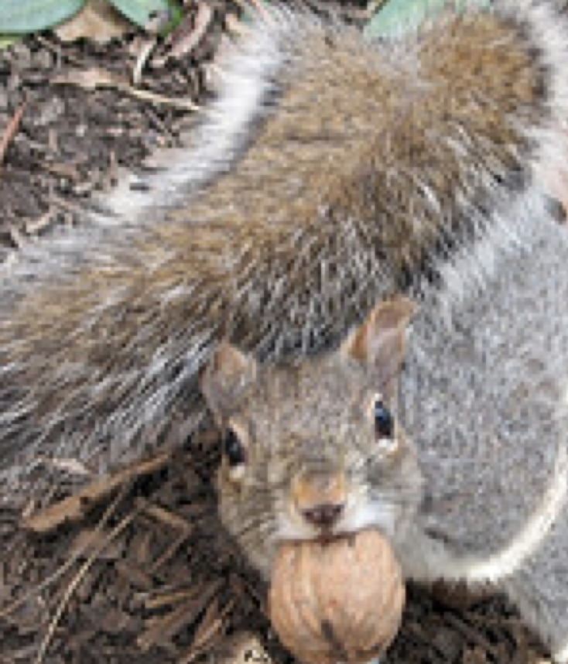

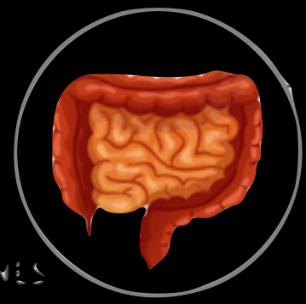
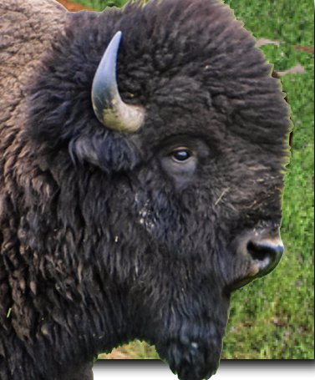
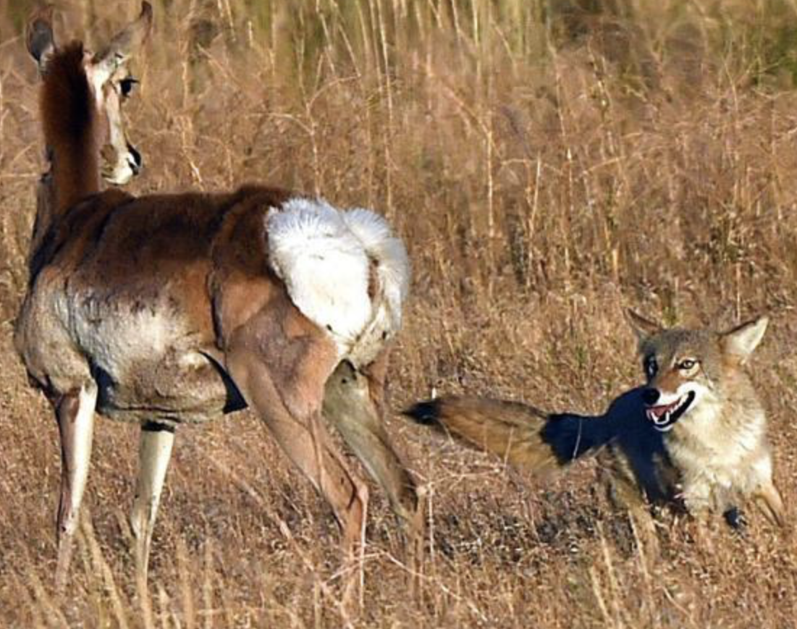
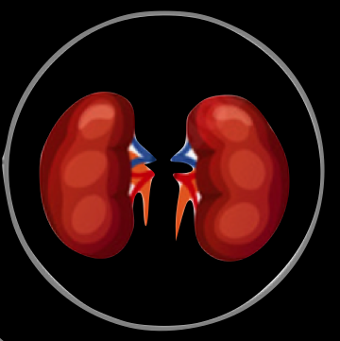
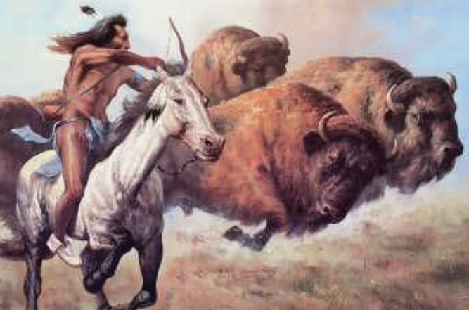

Gaia Hypothesis: Earth is inhabited by Nature —
“a kind of living organism” with various living components (plants and animals) that function like organs performing life functions.

Slide 23
“Without the benefits of Gaia mutualism, one or even both of the interacting species in the living organism that is Nature can be diminished or may even cease to exist.”
How important is awareness of this?

Slide 24
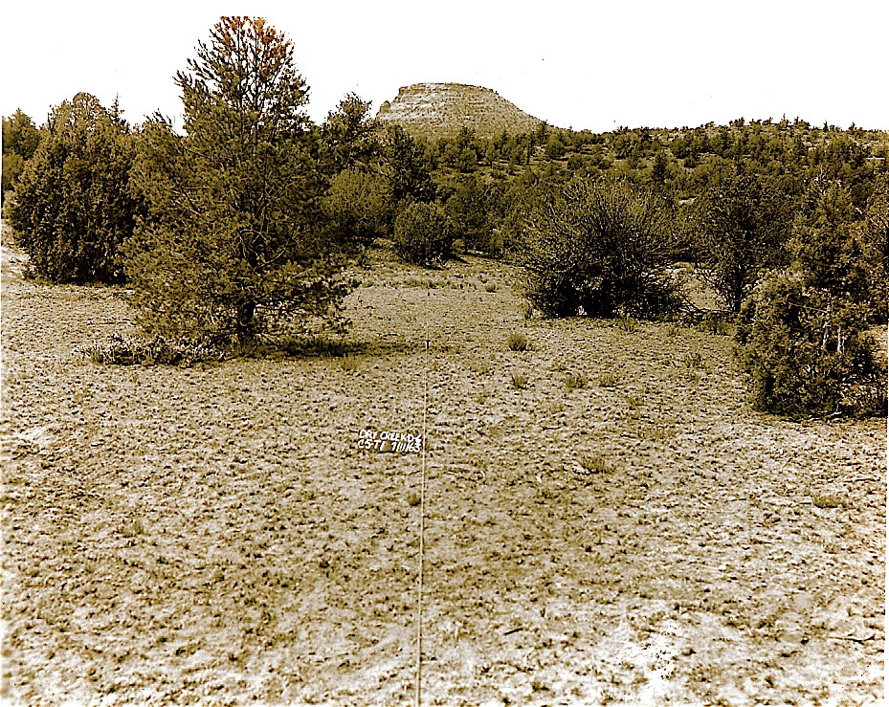
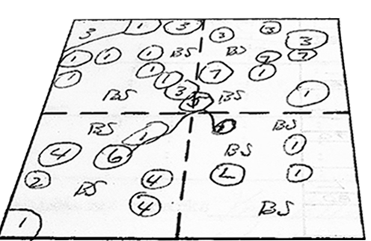
one or more of the interacting species CAN be reduced or even cease to exist?
Here’s some US Forest Service land near my home in Sedona while it was being grazed and monitored in 1963.
Photo courtesy of U. S. Forest Service
1963

Slide 25
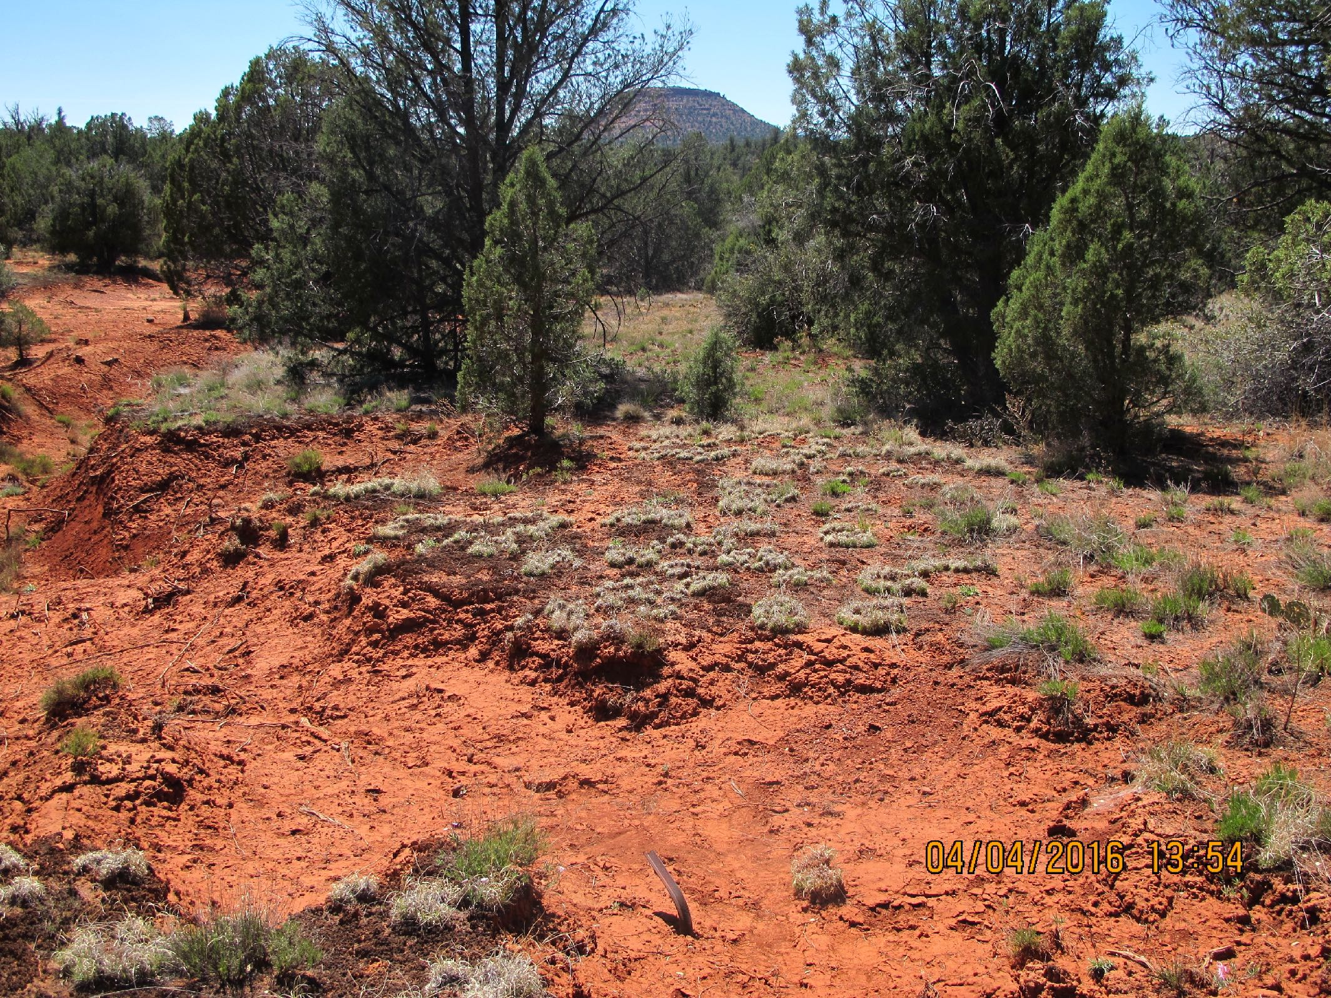
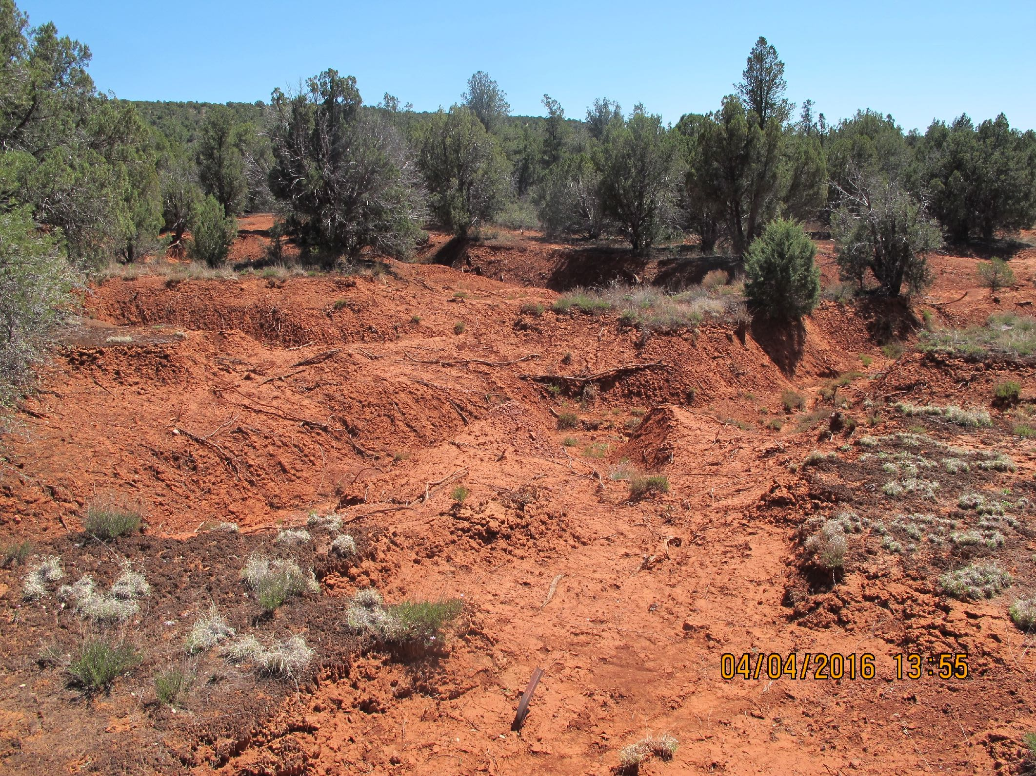
Grazing was removed in the 1980s and then.…
1963
Take a look to the left
1963
Photo courtesy of U. S. Forest Service

Slide 26
Nature Is telling us something…
1963
mutualism ended — when one or more of the interacting species is reduced or removed, that may cause some of the others to cease to exist.

Slide 27
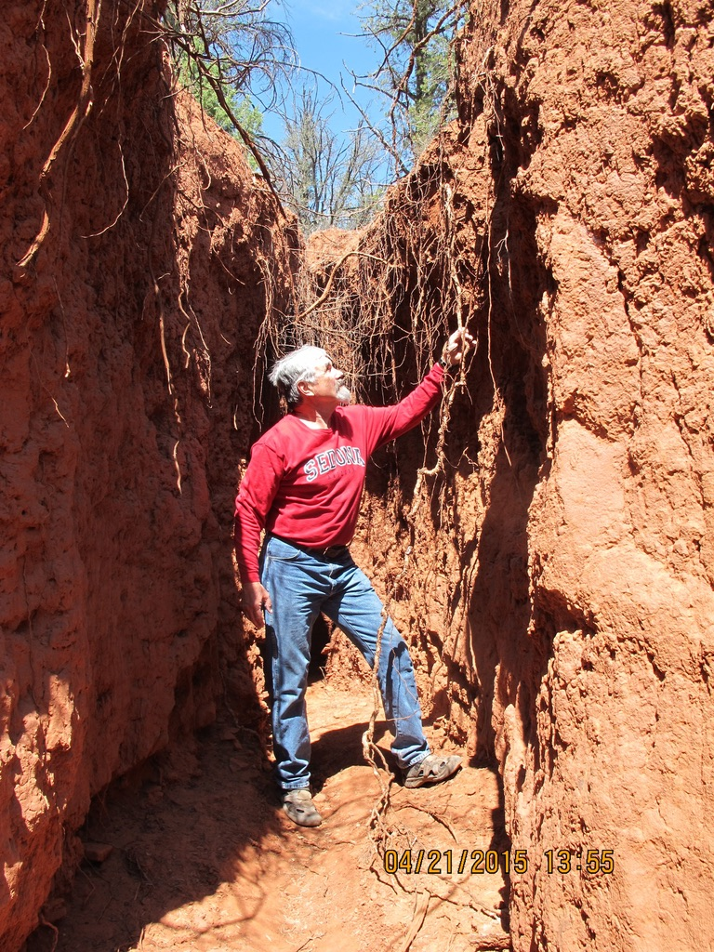
The main watercourse through the drainage has deteriorated even more!
And been renamed…

Slide 28
IN THE ARID SOUTHWEST, Riparian AREAS are AMONG the MOST VALUABLE WILDLIFE HABITATS
Riparian area ALONG
THE UPPER VERDE RIVER IN 1963
grazed
80% native fish including a threatened species — the spikedace

Slide 29
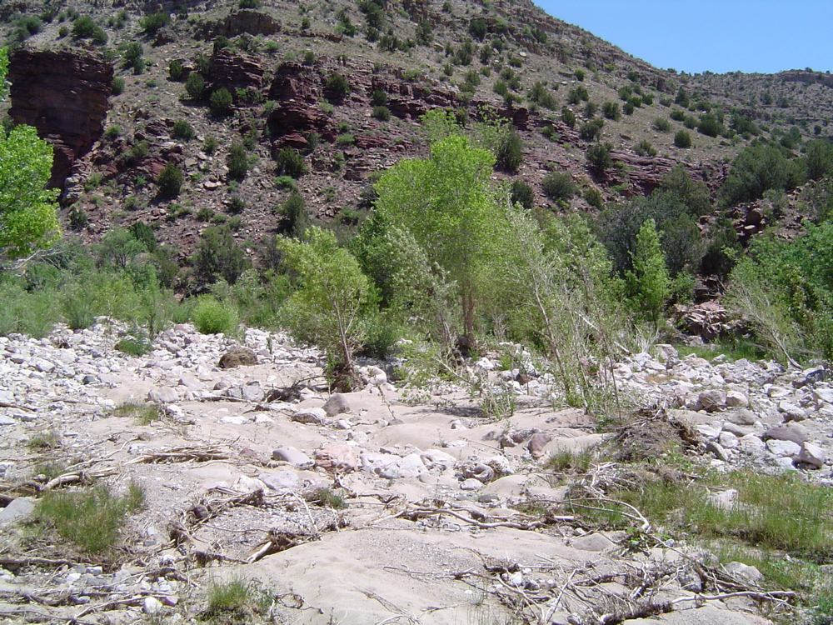
UPPER VERDE – 2005 CATTLE REMOVED in 1997
to save A threatened FISH (spikedace)
R. I. P.
spikedace

Slide 30
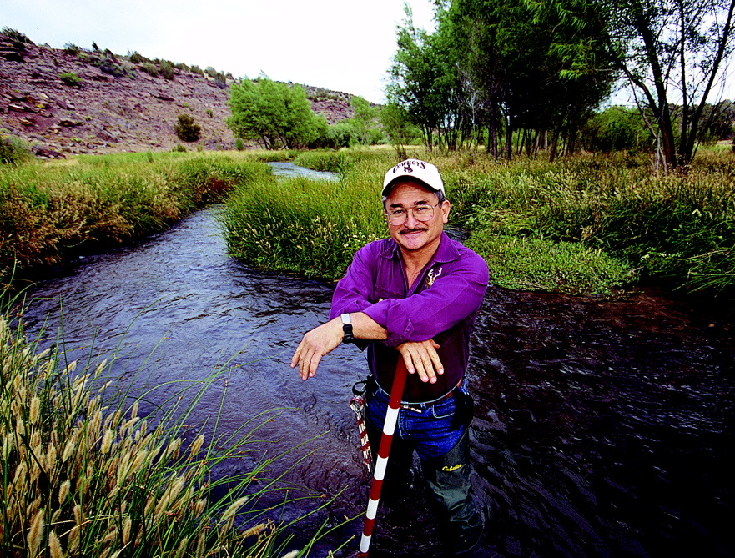
private land upper verde
shared goals grazed so effectively
USFS SCIENTISTS nicknamed IT
“The Little Slice of Heaven”
Protected
Protected

Slide 31
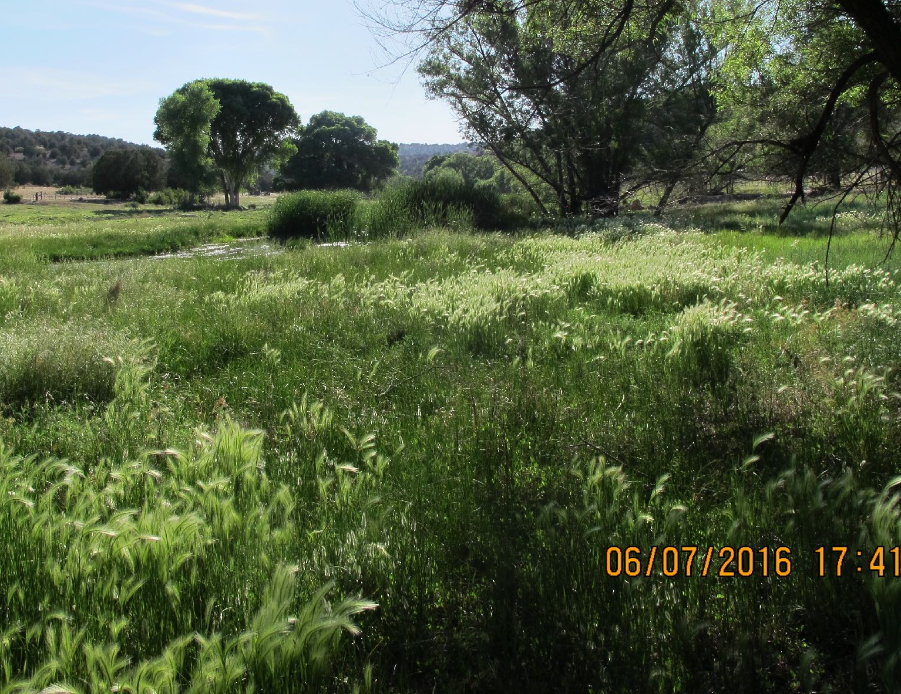
LITTLE SLICE OF HEAVEN 2016
(Shared goal-grazing continued)

Slide 32
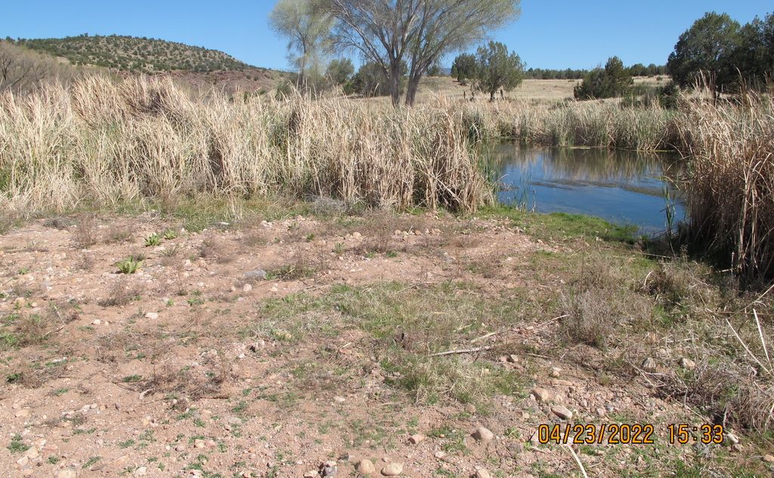
LITTLE SLICE OF HEAVEN
grazing removed 2017
https://us02web.zoom.us/j/85098806665
R. I. P.
NATURE SENDs US this MESSAGE a lot…

Slide 33
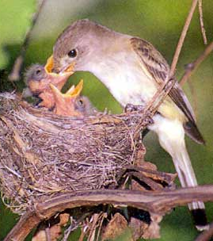
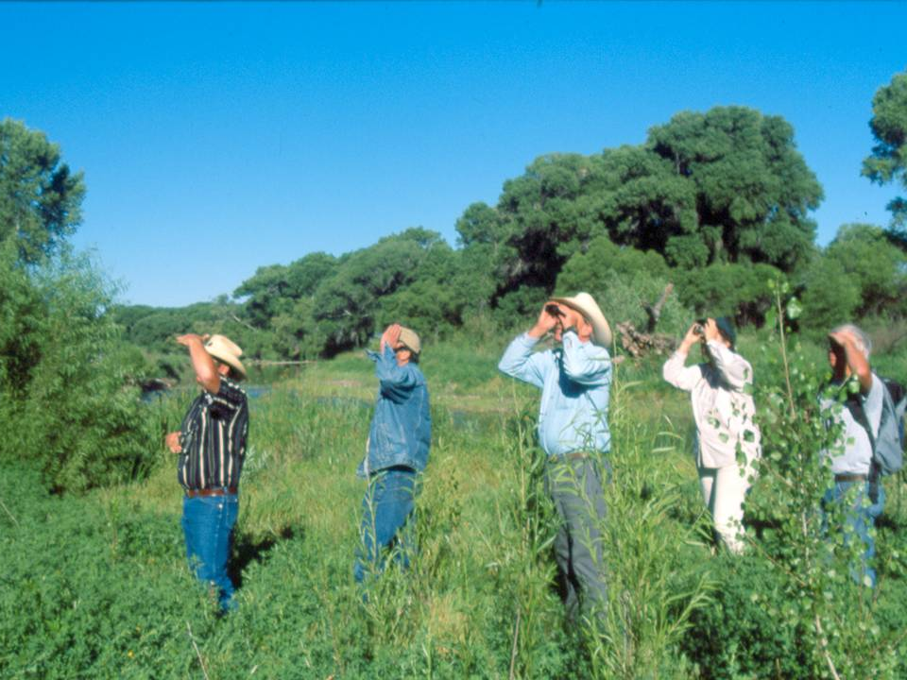
NATURE’S MESSAGE
GILA RIVER, NEW MEXICO
shared goal GRAZED
Southwestern willow flycatchers
spikedace
YELLOW-BILLED CUCKOOS
HOME TO:
AMONG THE LARGEST KNOWN POPULATIONS OF threatened and endangered…

Slide 34
More of nature’s message…
restore mutualism
By REVIVing IT
Regenerative grazing applied - Seeds, hay and Nature-mimics…

Slide 35
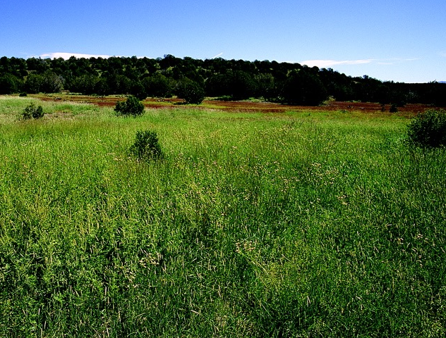
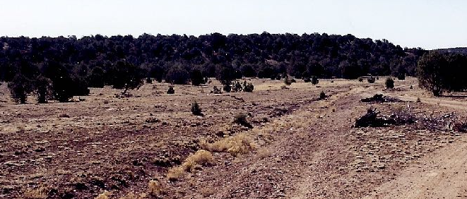
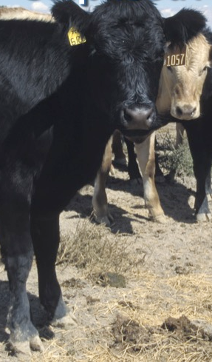
Before
What are we waiting for?
The results one year later!

Slide 36
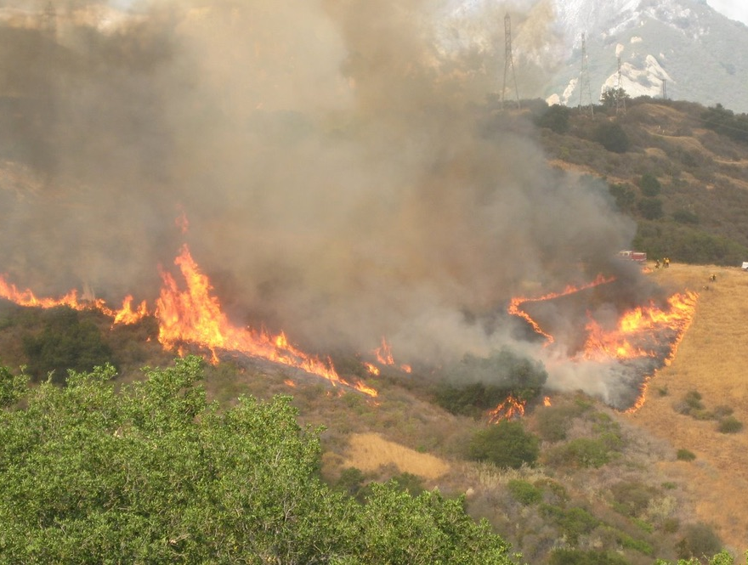
WHAT about THE surge of WILDFIRES CURRENTLY impacting the AMERICAN WEST?
cAN we partner with nature to help mitigate that?

Slide 37
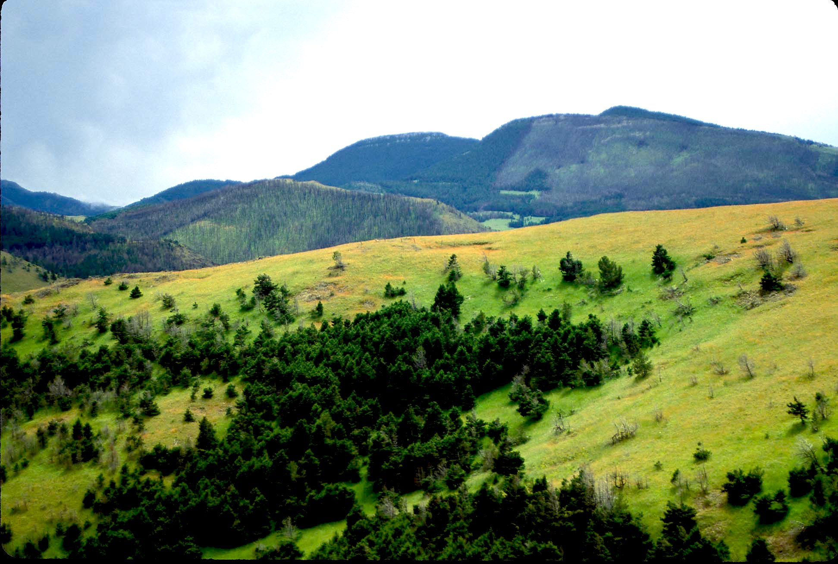
Notice where this fire stopped
The area THAT DIDN’T BURN has been grazed in a manner to MAKE IT VITAL, GROWING, GREEN, AND THEREFORE LESS FLAMMABLE
(From the chapter “Eden in Flames” in my book: Gardeners of Eden)

Slide 38
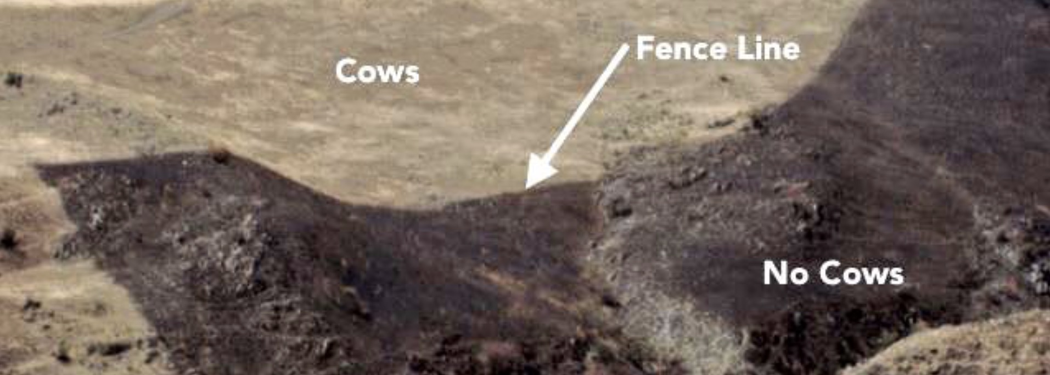
More Examples
UNGRAZED
GRAZED
Didn’t burn
Burned
UNGRAZED
UNGRAZED
GRAZED
Burned
Didn’t burn
GRAZED
Didn’t burn
UNGRAZED-Burned

Slide 39
Regenerative Grazing can not only reduce wildfire danger
Rain THAT falls on fire-denuded slopes Rushes downhill
it can reverse some of the severe damage wildfire causes

Slide 40
BEARING LOTS OF SOIL, ASH, AND LITTER

Slide 41
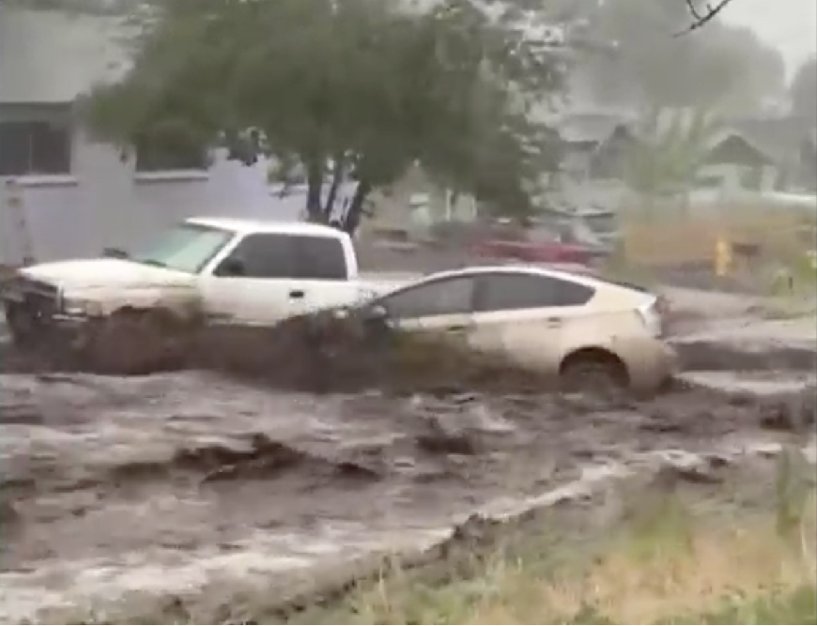
FLOODING NEIGHBORHOODS in COMMUNITIES LIKE FLAGSTAFF

Slide 42
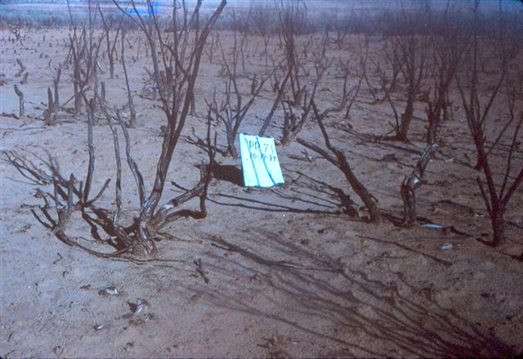
This land near Grand Junction, Colorado was burned by a large wildfire 4 years before this photo was taken.
Here’s a rejoining nature way to mitigate some of the severe damage wildfire causes

Slide 43
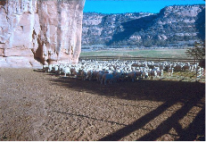
A flock of sheep served as “regeneration workers.”

Slide 44
The sheep applied their healing touch by stomping in seeds and mulch from hay provided by “together workers”
Plus they added a little fertilizer of their own.

Slide 45


WORKING TOGETHER restoration:
One year’s worth of results
4 years of leave it alone restoration
Green and growing
Sequestering carbon
RESISTING eroSION
Recovering from HABITAT LOSS

Slide 46

consider this pile of copper mine waste near Globe, Arizona that dates back to the 1800s.
That brings us to one of the most eye-opening restorations ever that affirms regenerative grazing really is…
Working together with nature

Slide 47


A number of attempts have been made to restore it using conventional methods.
1,000 + acres huge.

Slide 48

Even leaving the job up to Nature for a very long time hasn’t been effective.

Slide 49

In the 1980s Terry Wheeler – biologist, innovator, rancher – offered to apply the plant-animal mutualism that he believed sustains natural grasslands to this wasteland.
Offer accepted, he applied seeds & hay plus what he called “FLOSB”s (Four Legged Organic Soil Builders) to stomp in and fertilize the mix.

Slide 50

Wheeler believed Nature creates & sustains grasslands with herds kept moving by predators (including humans).
So, he kept his FLOSB’s in herds
& moved them regularly – like Nature.

Slide 51

Here’s the results!
Before
After FLOSBs!

Slide 52

Another after FLOSB
photo
date… 8/26/2021

Slide 53

FLOSBs doing a regular touch-up

Slide 54

CLIMATE CHANGE?
Notice the brown?
Grazing the “FLOSB” way removes carbon from the amosphere by pumping it into the soil. Here’s 12 inches of soil carbonized by FLOSB restoration.
That’s carbon
sequestered by FLOSBs!

Slide 55
As we learn that rejoining nature via regenerative agriculture is so valuable for US AND FUTURE generations…
We need to come up with a way to reward those who apply it EFFECTIVELY AND achieve THE GOALS WE SHARE!

Slide 56
THE GOOD NEW IS:
ENVIRONMENTAL GROUPS ARE LEARNING TO REWARD INDIVIDUALS AND GROUPS FOR ACHIEVING ECO-RESULTS RATHER THAN APPLYING POLITICAL PRESCRIPTIONS

Slide 57
Conservation Ranching
Audubon has initiated a program to enable ranchers who are healing and sustaining grasslands and bird habitat to label their beef with Audubon’s “Grazed on Bird-Friendly Land” label and sell it for an extra 50 cents to $2 per pound
100 ranches 3 million acres
Largest regenerative grassland partnership in the US
Empowering consumers to make a difference in grassland conservation.

Slide 58

World Wildlife Fund
“Grasslands evolved to be grazed”.
Intact grasslands not only conserve biodiversity, but ensure cleaner streams, and more carbon stored in the soil.
The feeding activities of herbivores: provide patches of vegetation across the landscape which wildlife utilizes, breaks dry ground allowing water to be absorbed into the soil, and returns nutrients and organic matter to the soil through manure.

Slide 59

Regenerative Grazing Lands
Livestock grazing on intact, working grasslands can help secure clean water, enhance habitat, address climate change and sustain rural communities.
September 11, 2020 | Latest update December 05, 2024

Slide 60
— Supporting the Cheyenne River Sioux Tribe’s efforts to use grazing to restore and sustain the comeback of America’s magnificent grasslands and the culture, people and wildlife it supports.

Slide 61


EDUCATION, INNOVATION, RESTORATION
ONE ACRE AT A TIME
EPISODE 111 – THE SEQUESTRATION SOLUTION: SOIL
by Lynne Whitbeck | Feb 22, 2022 | Climate Change, Down to Earth, Grazing, Rangeland Science, Soil, Working with Nature
Cooling the earth’s climate is not just about cutting emissions––it’s about removing masses of carbon from the air.
The Carbon Ranch — Its purpose is to mitigate climate change by sequestering additional carbon dioxide in plants and soils.

Slide 62
Why is REJOINING NATURE so valuable to so many of us?
TWO REASONS…
when people feel they are enmeshed with nature, they are not only greener in their behaviors but they tend to be happier &
RE-BECOMING part of NATURE ENABLES US TO HELP GAIA WORK AS IT EVOLVED TO WORK —
as THE LIVING EARTH

